Slide 1



Start!

Slide 2
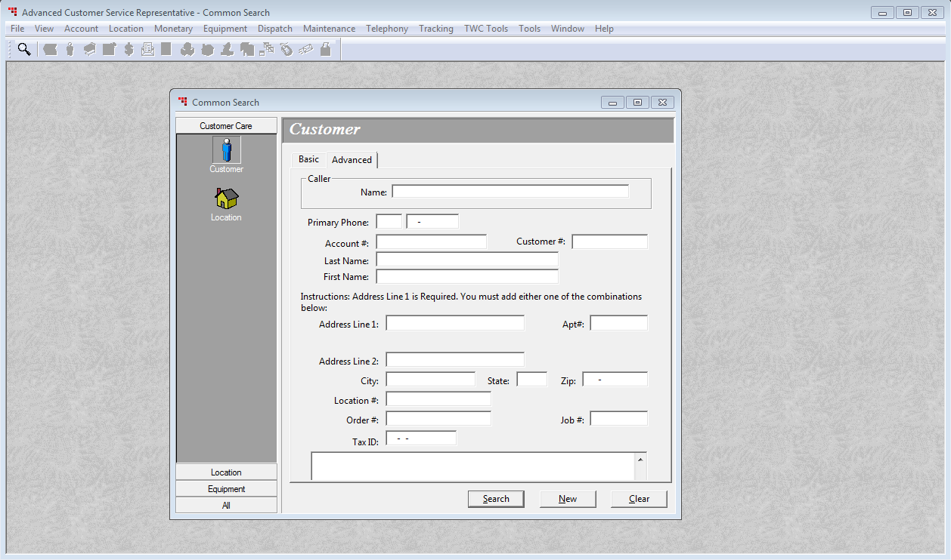
Let’s begin by entering an account number

Slide 3
8448200015592313
Now click Search

Slide 4
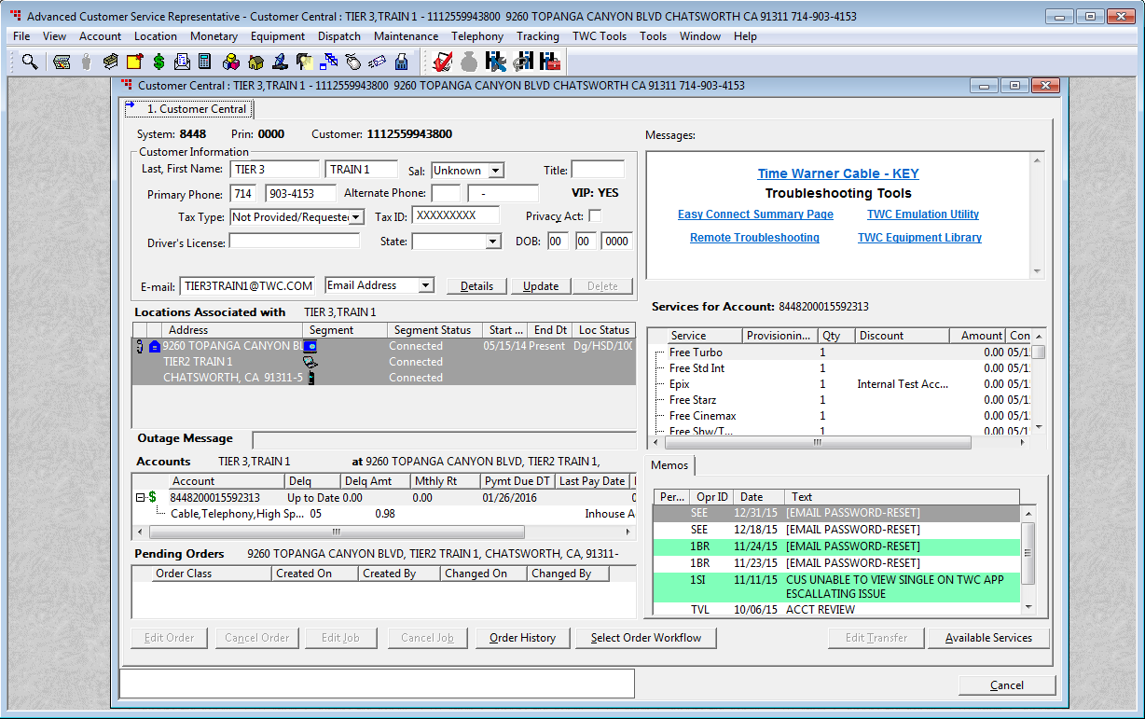
Click on Select Order Workflow

Slide 5
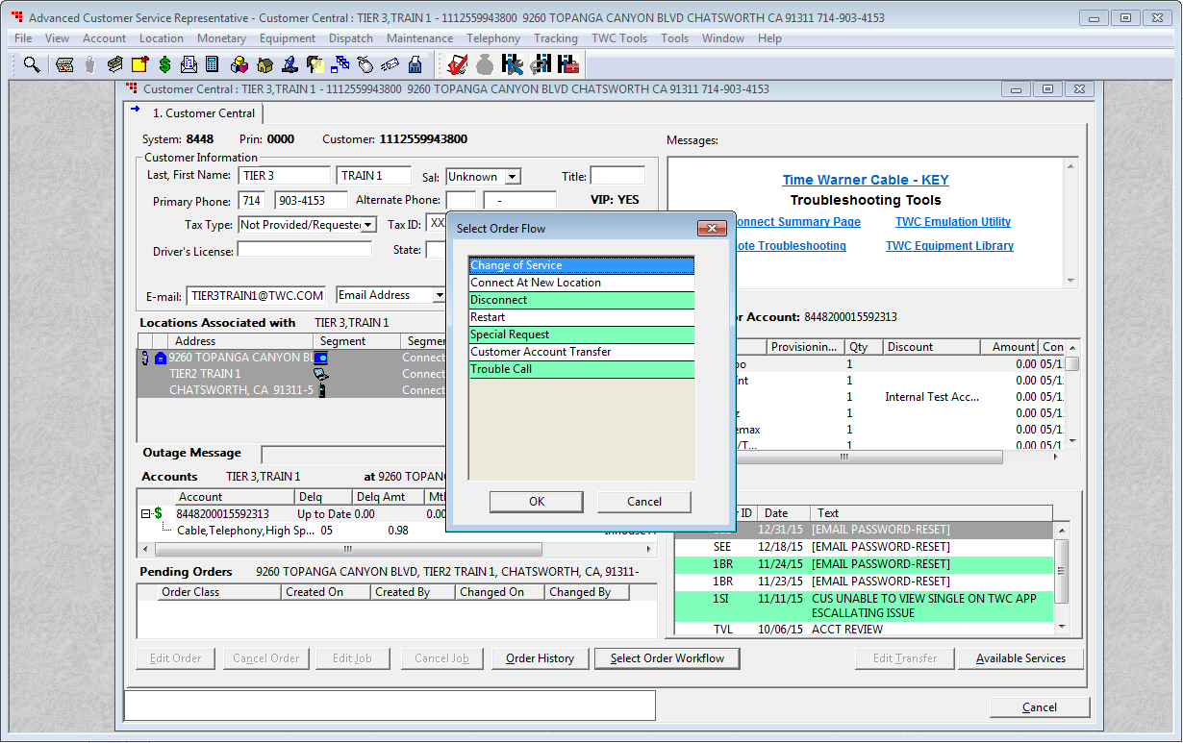
Make sure Change of Service is selected
Then click the OK button

Slide 6
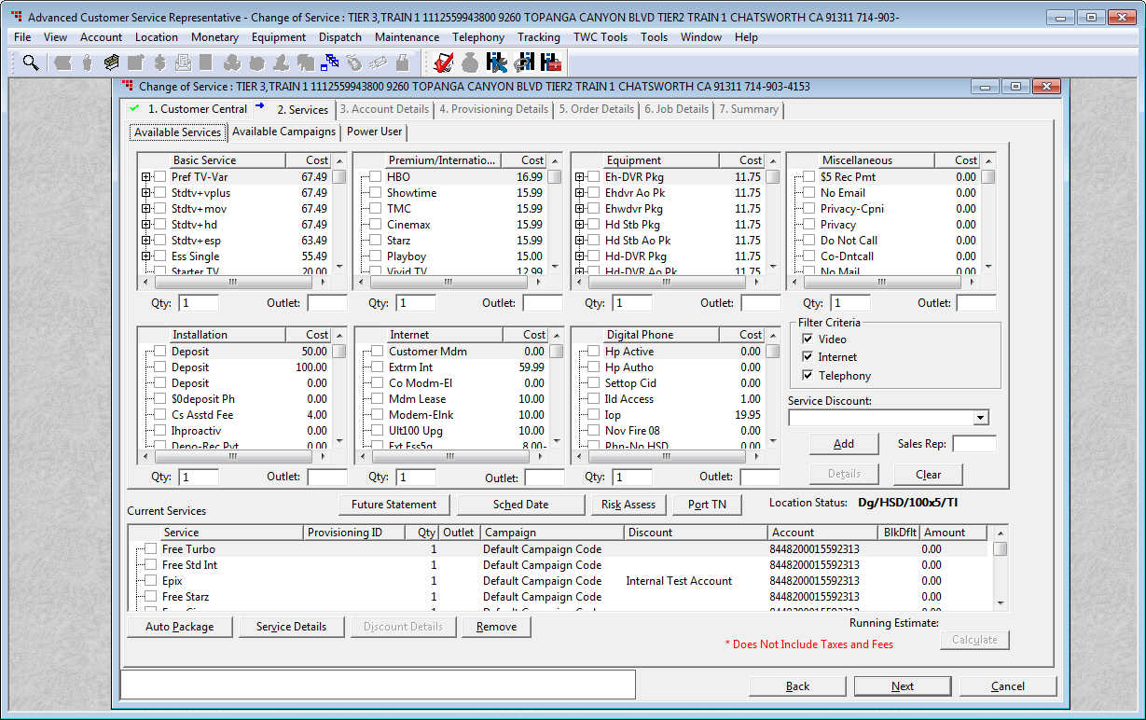
To get to the EZ Connect Codes click on Available Campaigns

Slide 7
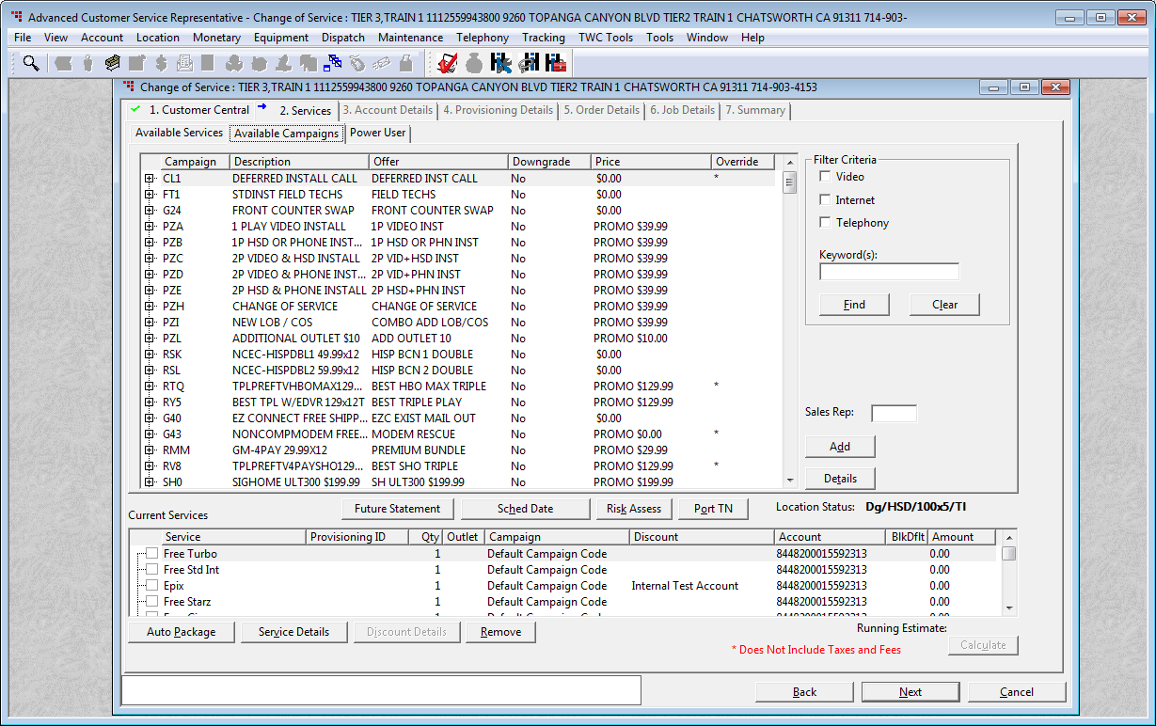

Search for the desired EZ Connect Pkg
EEM = Mail Out
EEP = Pick Up

Slide 8
Click Find
EEM

Slide 9
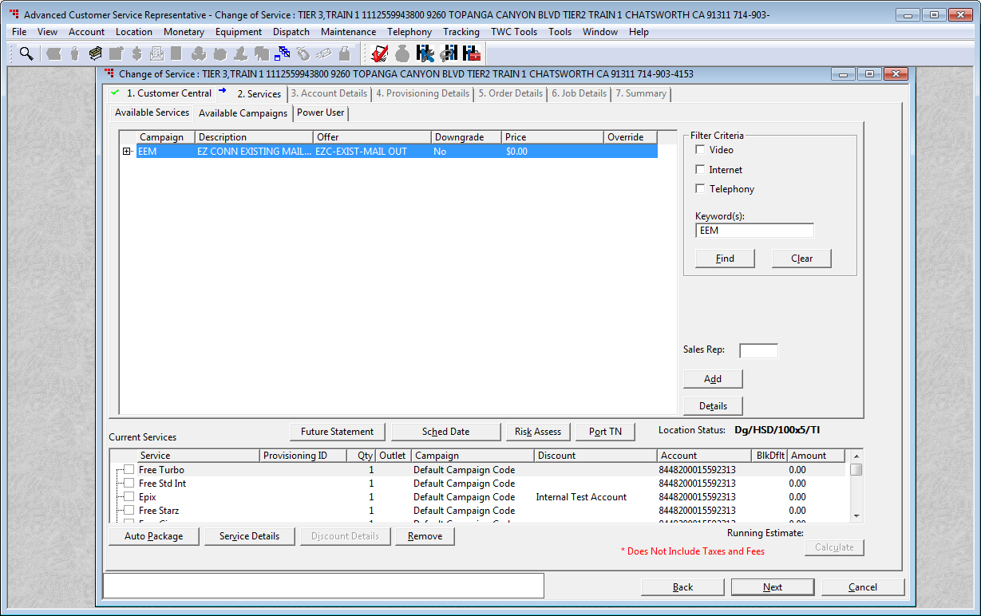
You can now either Double click on the line item or click Add

Slide 10
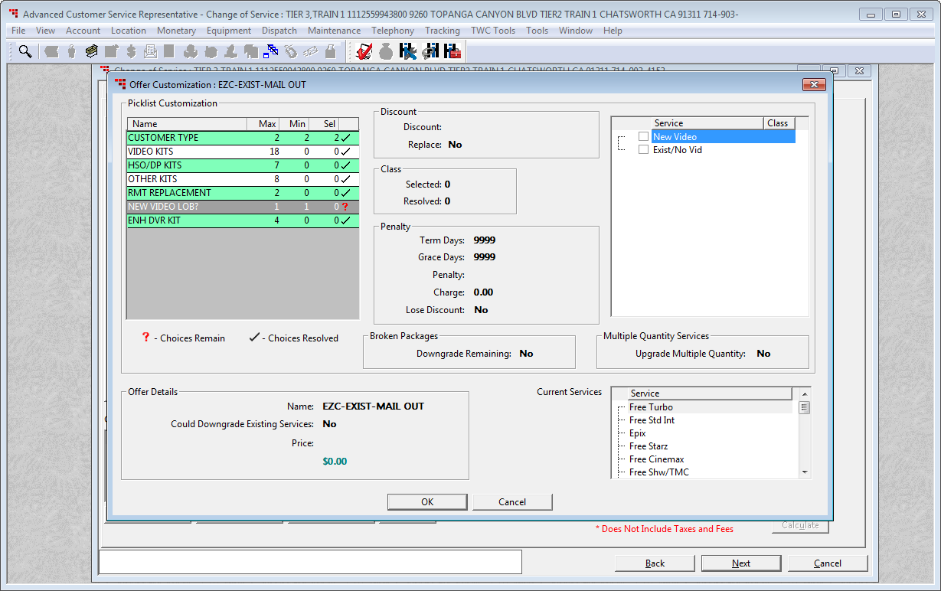
Determine if this is a New Video Subscriber, or an Existing Customer

Slide 11

Let’s say this customer wants to add a HD STB, click Video Kits

Slide 12
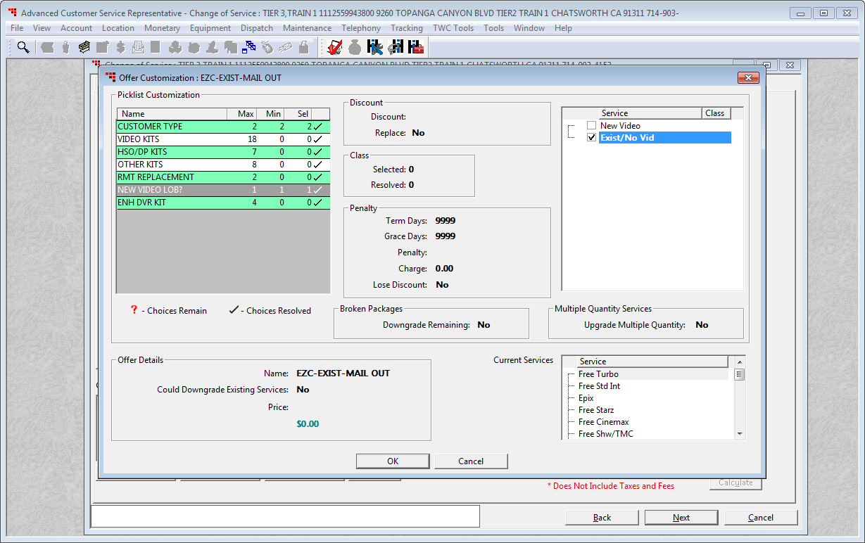
Let’s say this customer wants another HD STB, click Video Kits

Slide 13
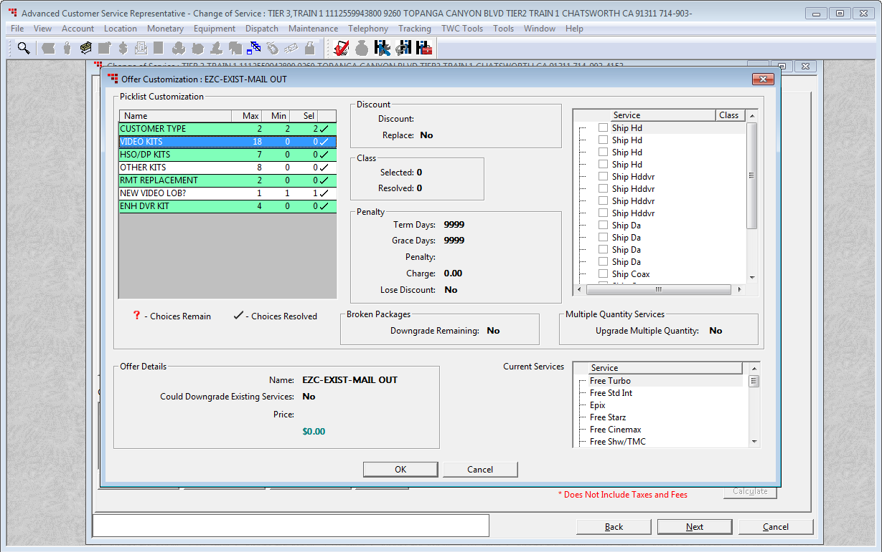
Select the equipment the customer is requesting, in this case select Ship HD for a HD STB

Slide 14
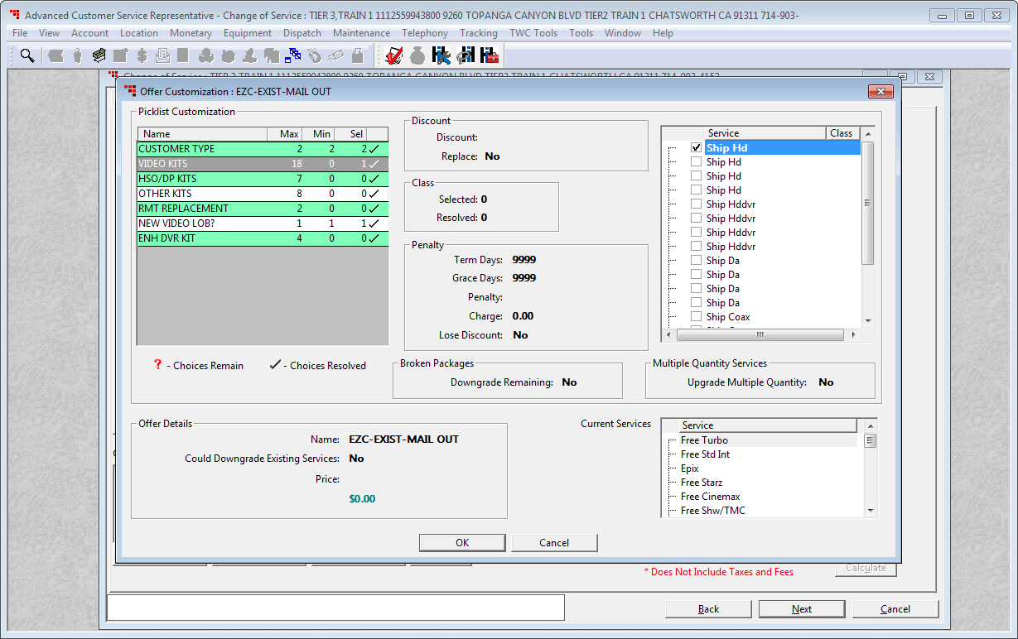
Click the OK button

Slide 15
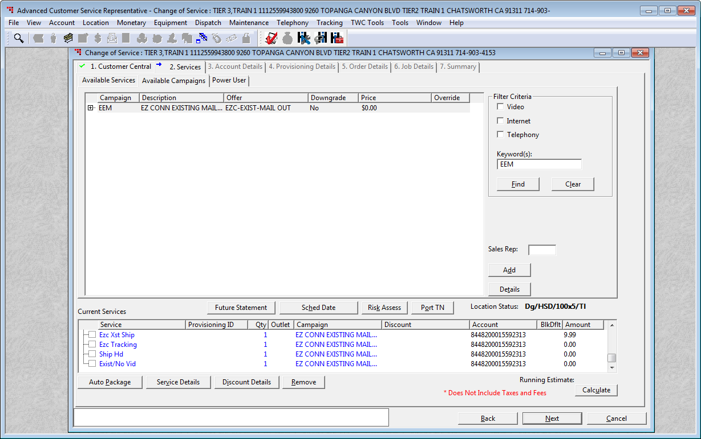
Notice your EZC codes are now in your order if you scroll to the bottom of the Current Services
Click the Next button

Slide 16
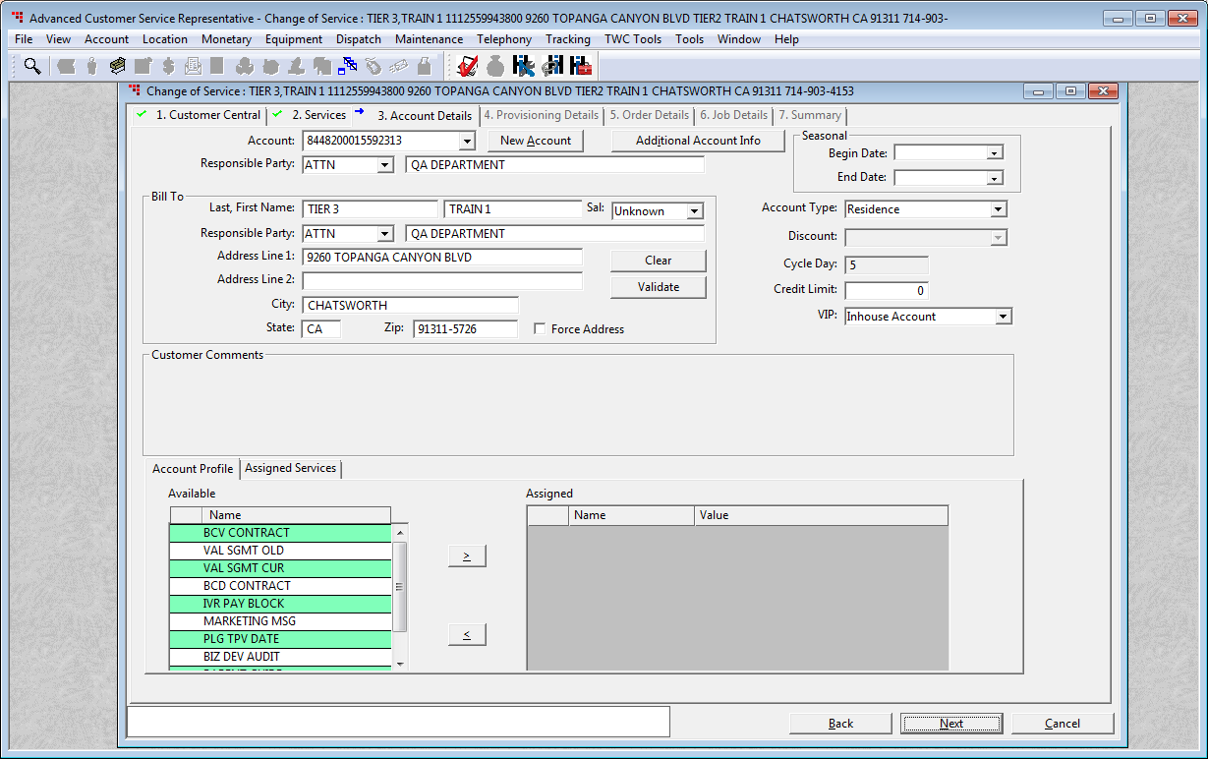
Click the Next button

Slide 17
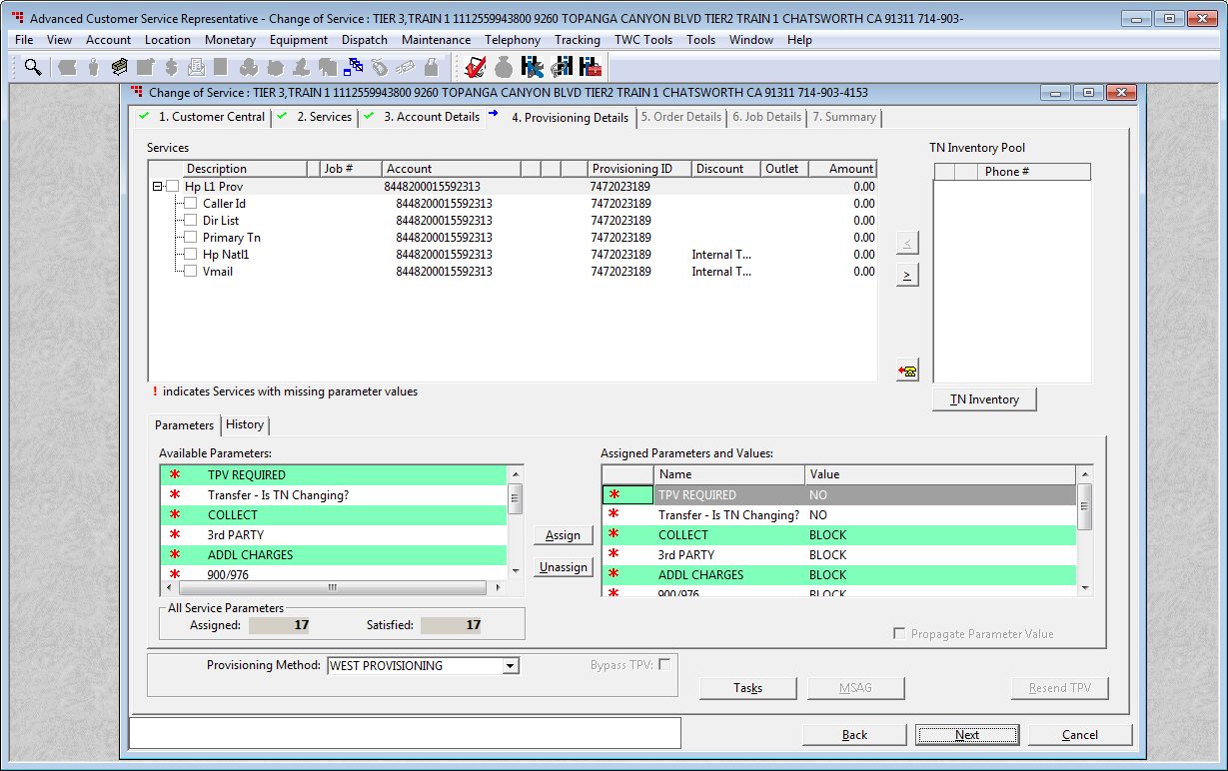

Unless you are adding phone to the order you do not need to fill this section out. If you are, fill out the require fields according to KEY. If you aren’t click Next.
Click the Next button

Slide 18
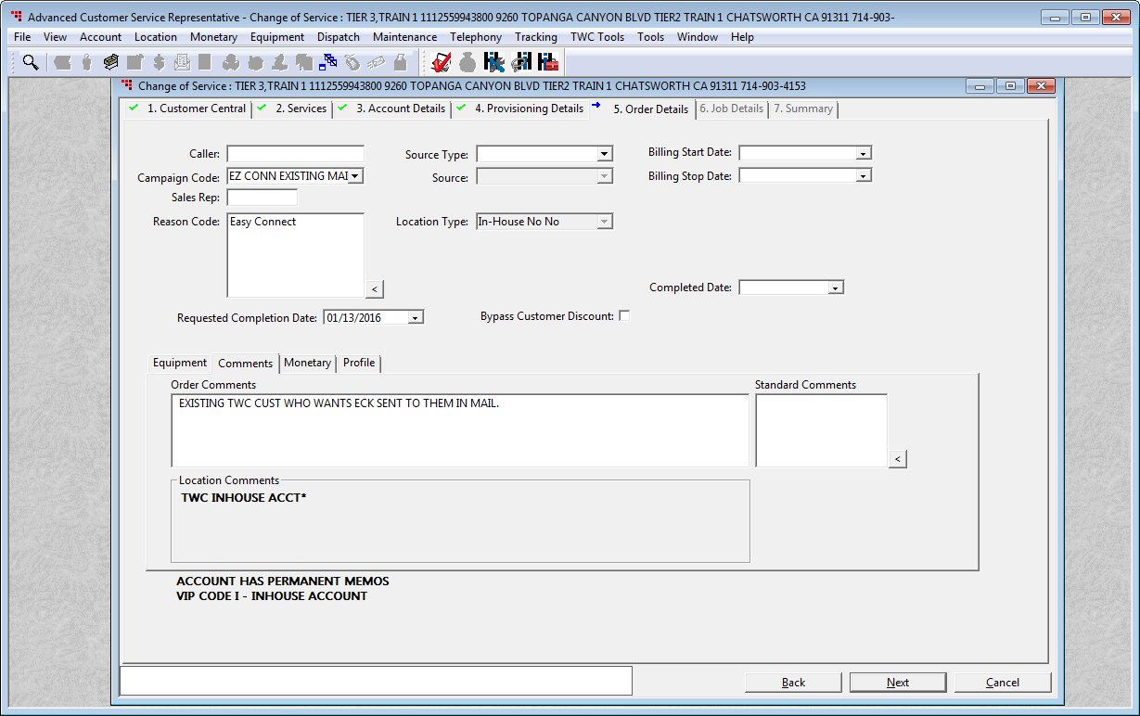
Type in your Sales Rep ID

Slide 19
11111
Click the Next button

Slide 20
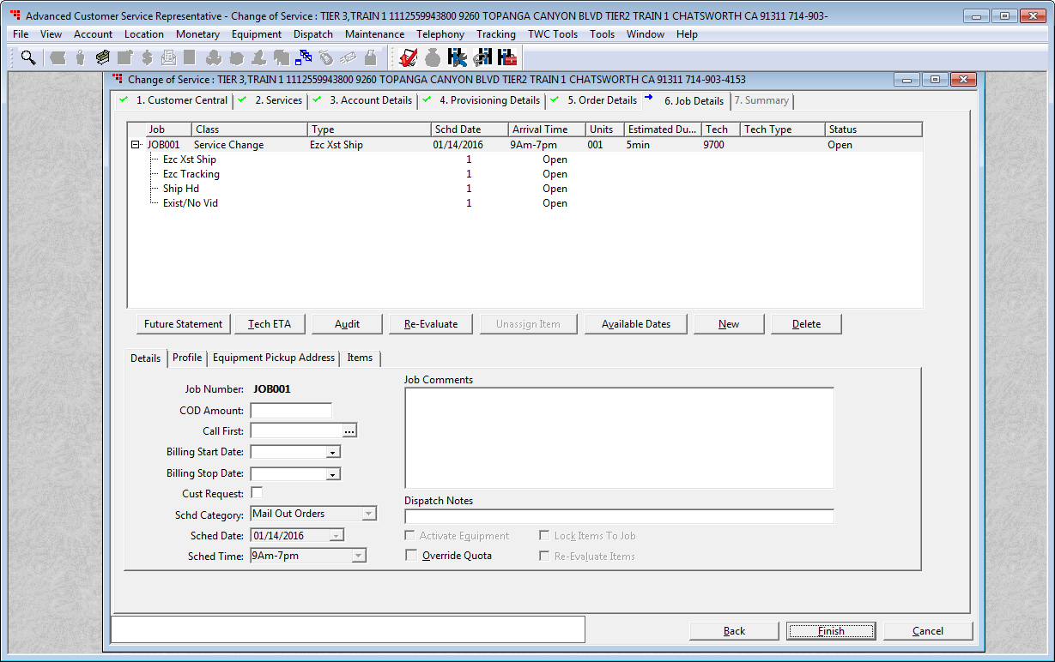
Click Available Dates

Slide 21
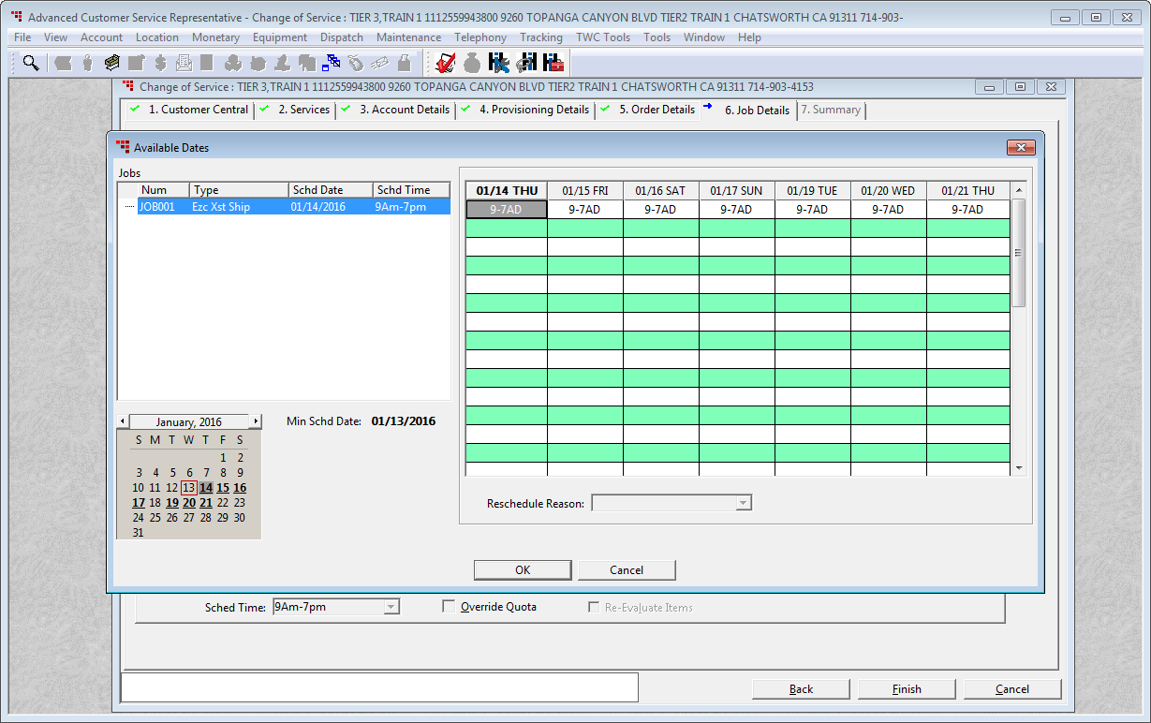

Push out for the required 5 days

Slide 22
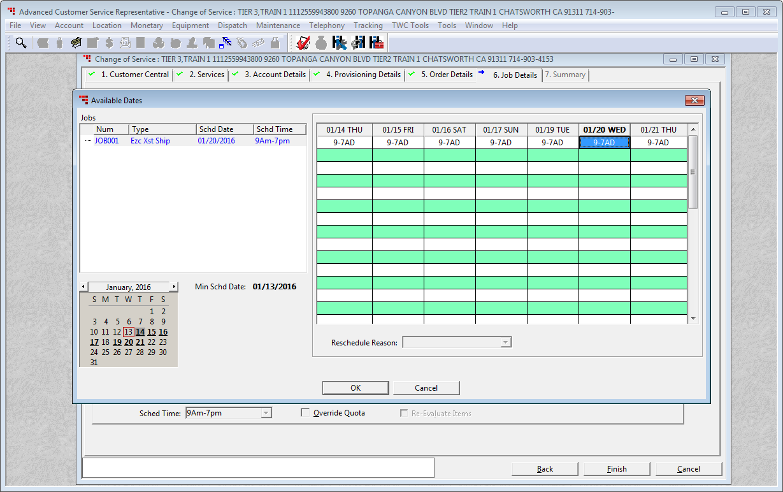
Click the OK button

Slide 23
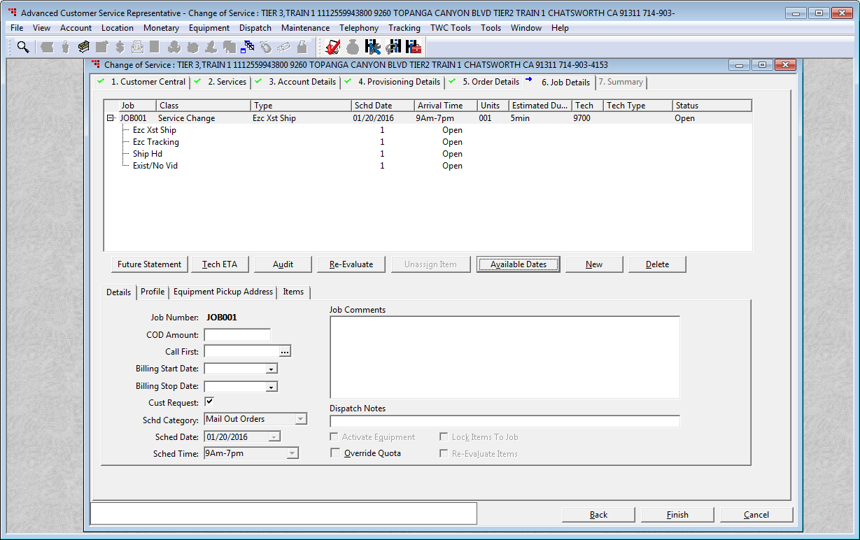
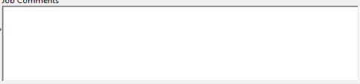
Add in your notes

Slide 24
Shipping HD STB
Click the Finish button

Slide 25








Here are some useful EZC KEY articles

